Slide 1
American Sign Language (ASL) Alphabet Recognition using Transfer Learning with ResNet-50

Slide 2
Table of Contents
Introduction
Objectives
Methodology
Model Evaluation Metrics
Results and Analysis
Conclusion

Slide 3
Introduction
What is American Sign Language (ASL)?
Importance of ASL in bridging communication gaps.
Challenges in ASL recognition (e.g., variations in hand gestures).
Aim: Develop an ASL alphabet recognition system using transfer learning with ResNet-50.

Slide 4
Objectives
To accurately classify 26 static ASL alphabet gestures (A-Z).
To leverage transfer learning with ResNet-50 to minimize training time and improve performance.
To evaluate the model’s effectiveness using precision, recall, F1-score, and confusion matrix.

Slide 5
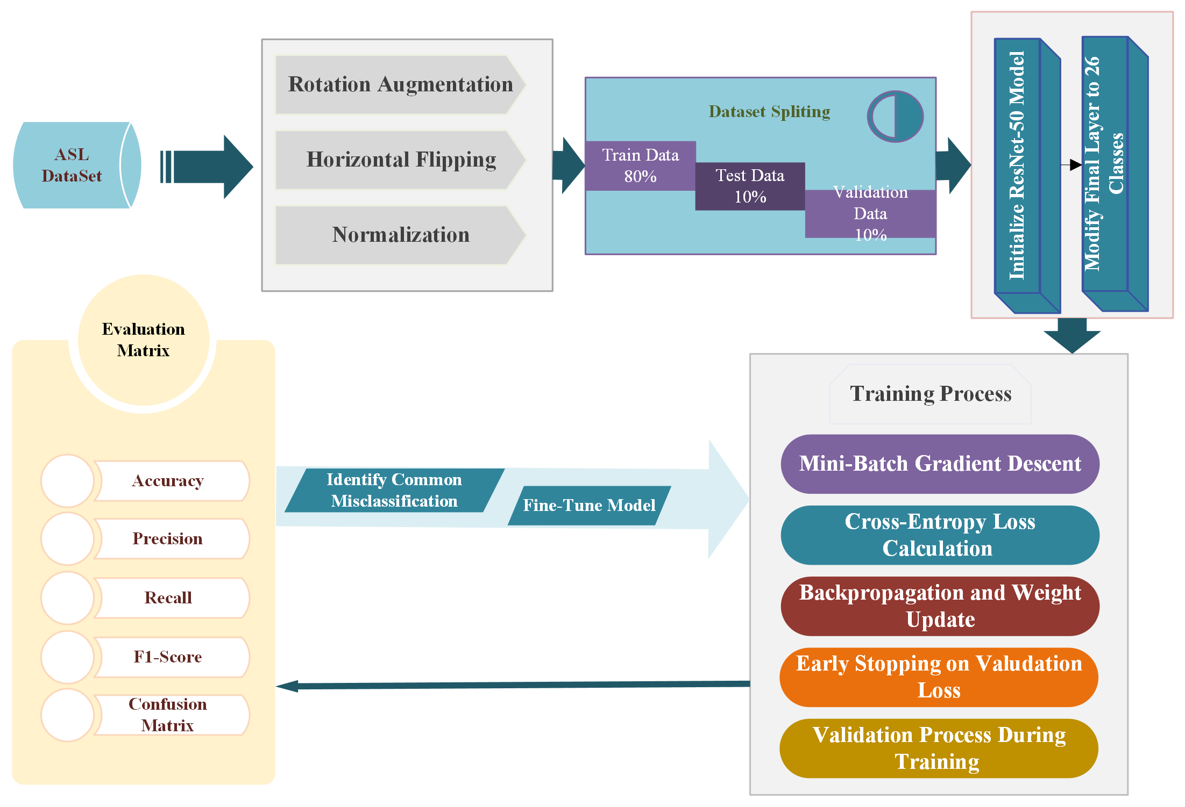
Methodology

Slide 6
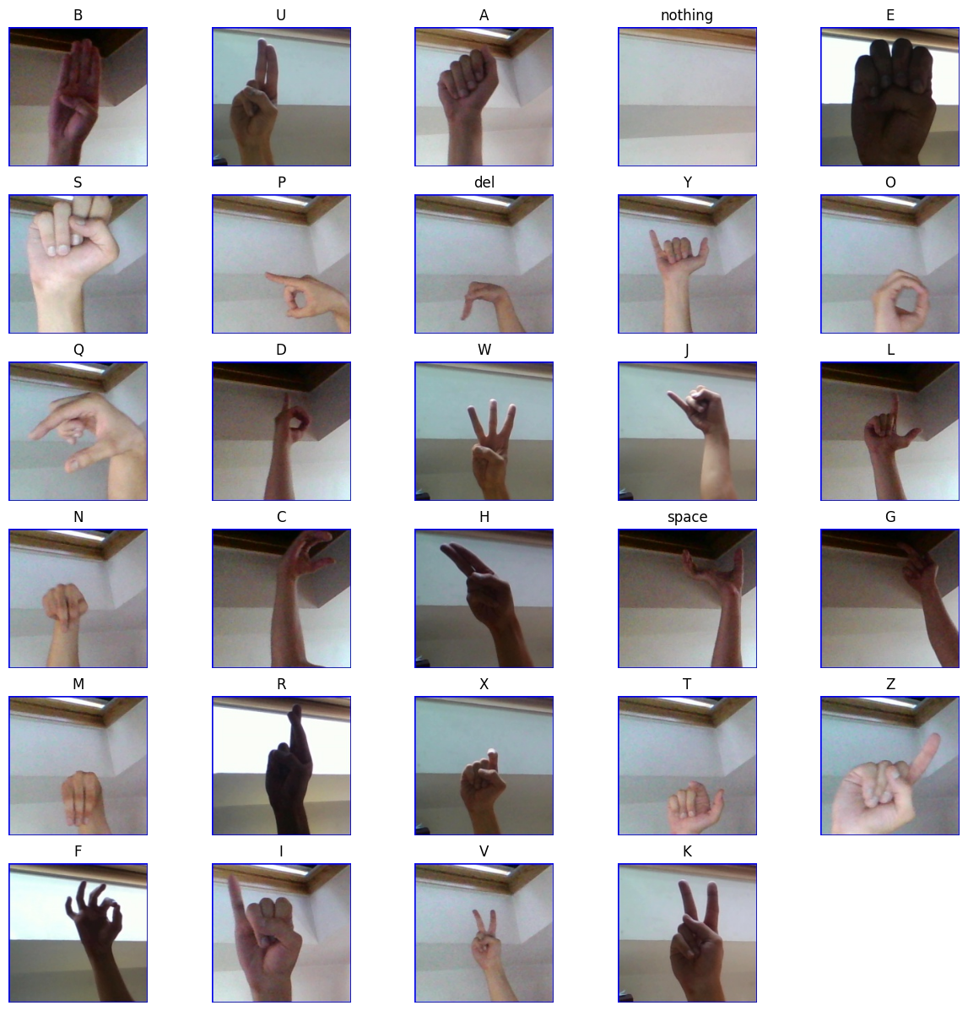
Dataset Description
Dataset: ASL Alphabet Dataset
Images: 87,000 images (26 classes)
Resolution: 200x200 pixels (RGB)
Dataset Splits:
Training: 80%
Validation: 10%
Testing: 10%

Slide 7
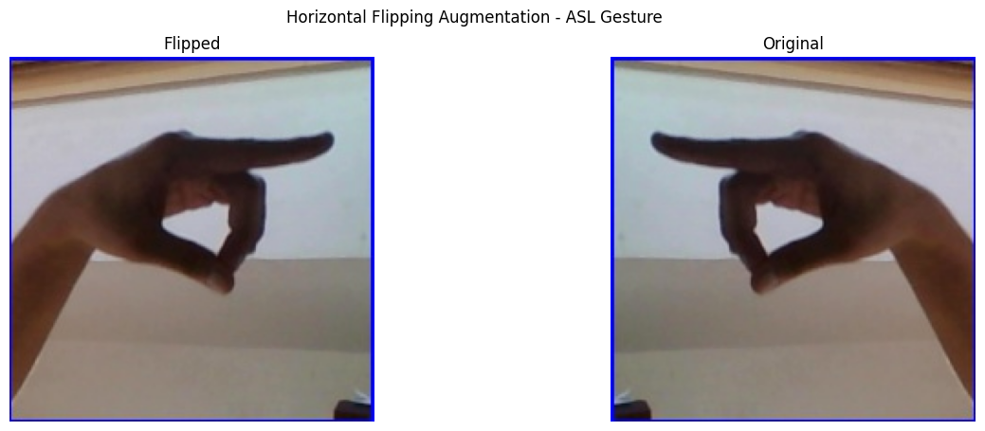
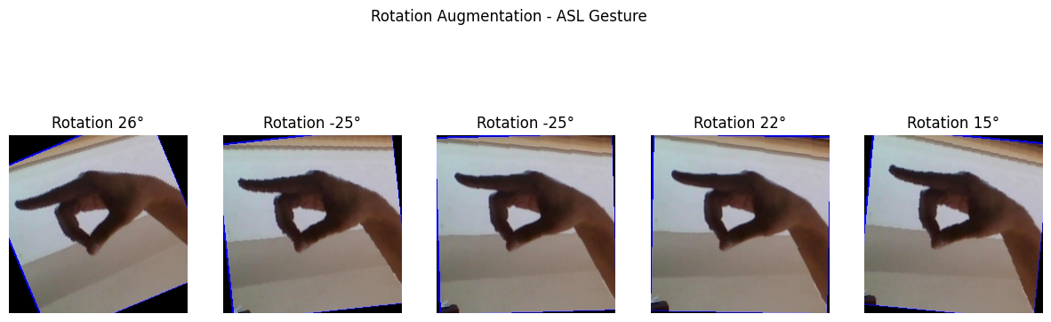
Data Preprocessing
Applied Techniques:
Rotation Augmentation
Horizontal Flipping
Normalization

Slide 8
Model Architecture - ResNet-50
Pre-trained ResNet-50 architecture:
50-layer deep convolutional neural network with residual connections.
Modified the final layer to output 26 classes (A-Z).

Slide 9
Training Process
Mini-Batch Gradient Descent used for efficient weight updates.
Loss Function: Cross-Entropy Loss
Optimizer: Adam Optimizer (Learning Rate = 0.001)
Early Stopping: Prevent overfitting by monitoring validation loss.
Number of epochs: 7

Slide 10
Model Evaluation Metrics
Accuracy: Proportion of correct predictions.
Precision: Proportion of true positive predictions out of all positive predictions.
Recall: Proportion of correctly identified positives.
F1-Score: Harmonic mean of precision and recall.
Confusion Matrix: Visualizing correct and incorrect predictions across all 26 classes.

Slide 11
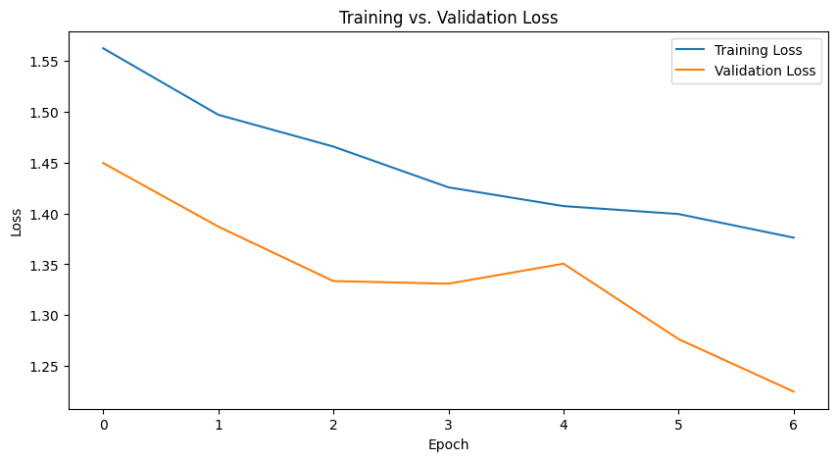
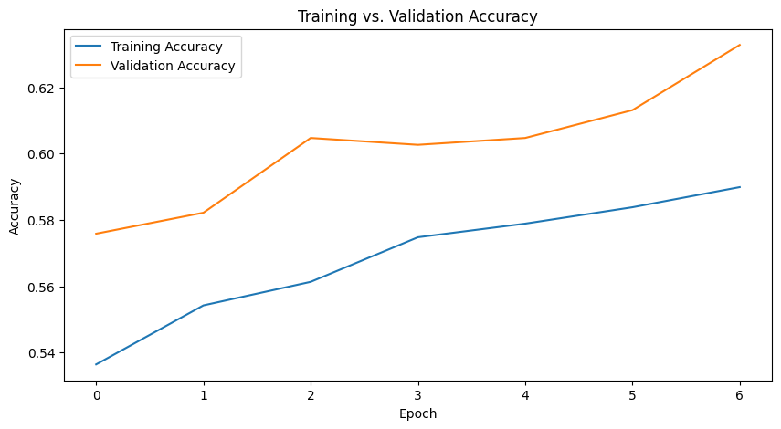
Results and Analysis

Slide 12
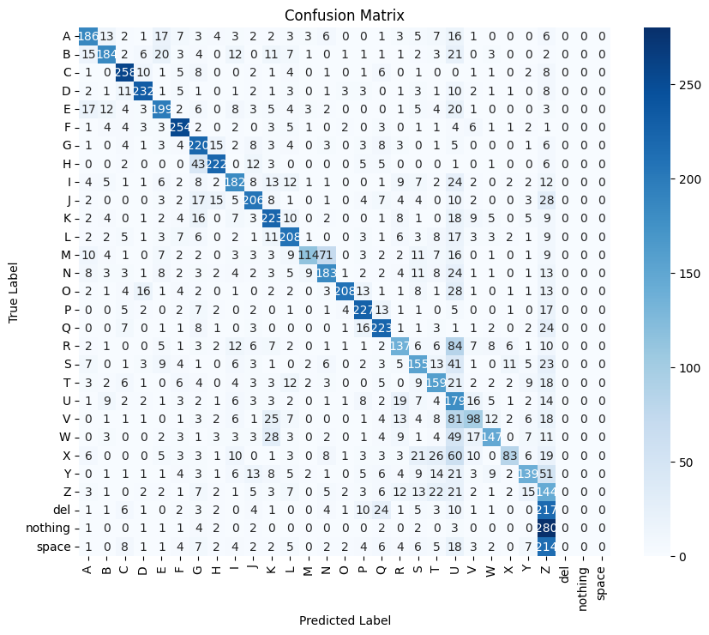
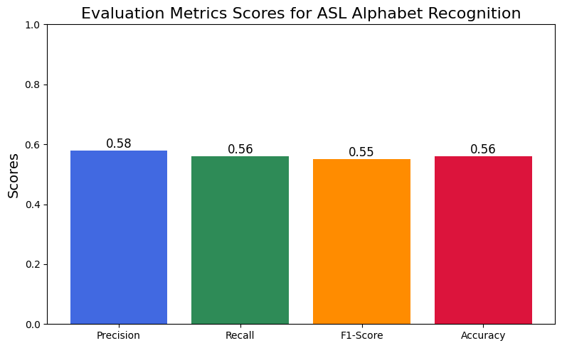
Results and Analysis

Slide 13
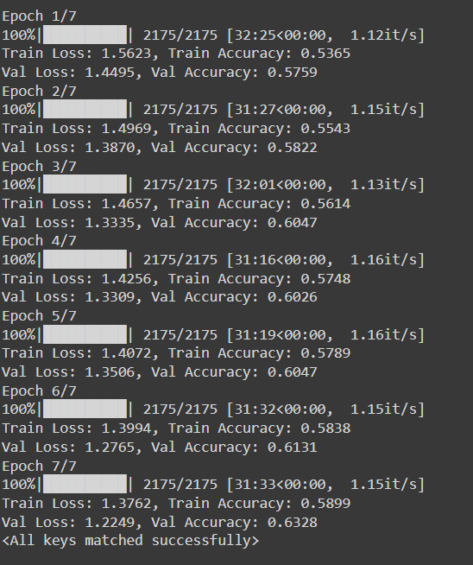
Justifications for Low Accuracy
Visual similarity between ASL letters causes frequent misclassifications.
Class imbalance and noisy data may hinder model performance.
Few Epochs

Slide 14
Thank you
Anik Sen
Master of Computing
MMU, Melaka

